Slide 1



Lecture-1 History of linux By : Naveen Tiwari
LINUX ADMINISTRATION
1

Slide 2


Linux
Linux is an open-source operating system.
It can run on 32 bit and 64 bit hardware.
Linux is a true multitasking environment.
Fully capable of taking advantage of multiple processors.
Can address up to 64 GB of RAM
**Linux is a kernel, not OS.

Slide 3
History of Linux
The history of Linux began with Unix in 1969.
Unix was created at Bell Labs with the goals:
Simplicity
Recyclable code
Written in C as opposed to assembly
Development started in 1991
Linus Torvalds wanted to create a free implementation of UNIX
By 1993 there were 12000 Linux users
Today Linux rivals UNIX in stability and scalability

Slide 4
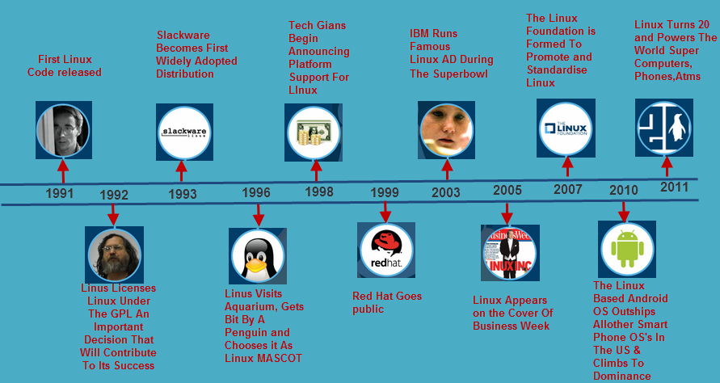
History of Linux

Slide 5
Operating System
OS is a software that acts as an interface between computer hardware components and the user.
computer system must have at least one operating system.
Examples : Apple macOS, Microsoft Windows, Google's Android OS, Linux Operating System, and Apple iOS

Slide 6
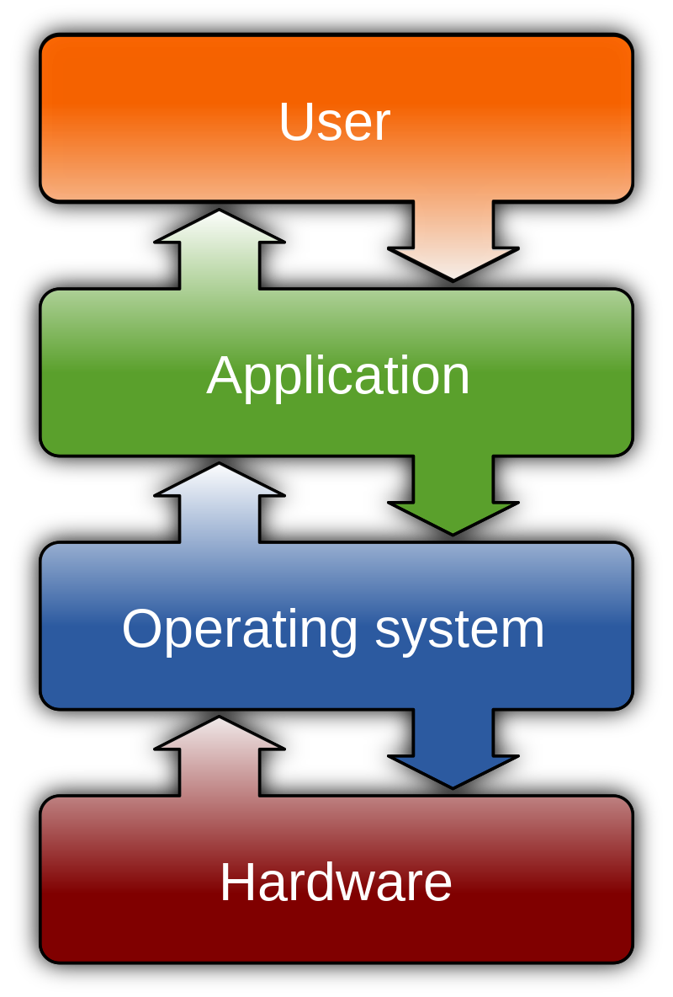
Operating System

Slide 7
Kernel
It provides an interface between application and hardware.
Hardware and software operations are managed and administrated by the kernel.

Slide 8
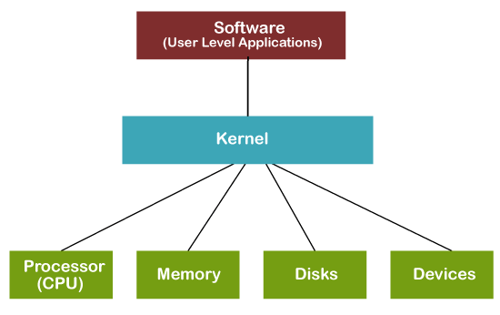
Kernel

Slide 9
Functions of a Kernel
Device Management
Memory Management
Resource Management
Handling system calls

Slide 10
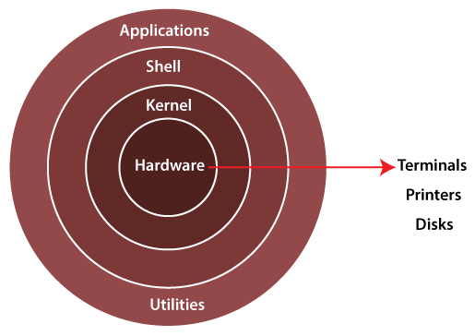
Linux Architecture

Slide 11
Linux Architecture
Kernel
System Library
System Utility Programs
Hardware layer
Shell

Slide 12
Advantages
Linux is free(open source)
Security
Customization
Lightweight
Stability
Performance

Slide 13
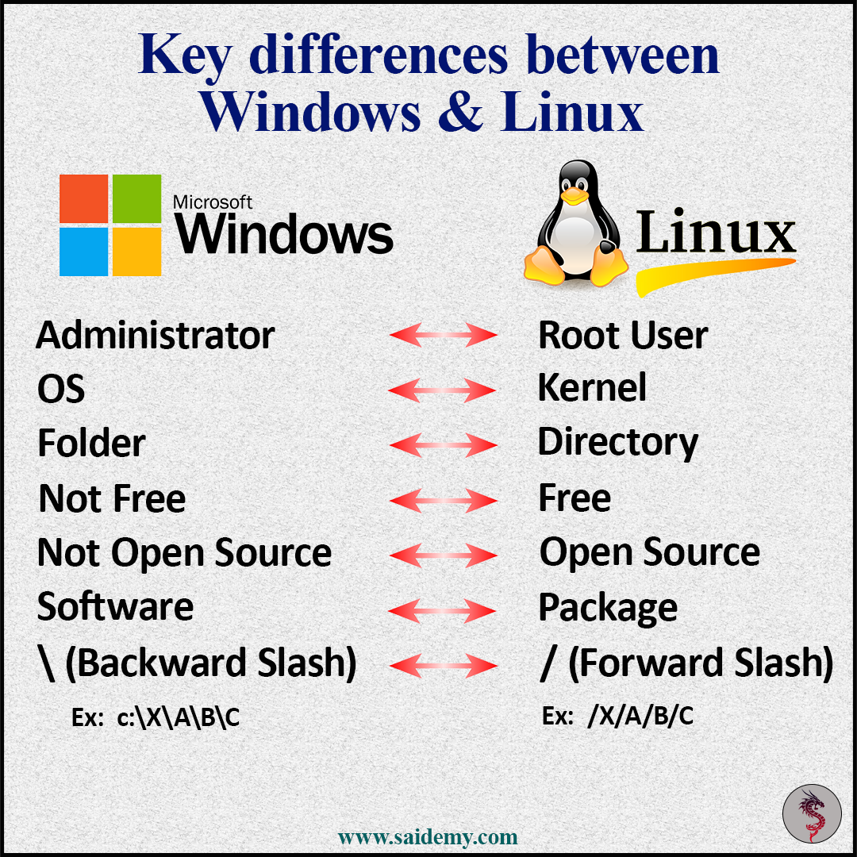
Difference between Windows and Linux

Slide 14
Linux Foundation
The Linux Foundation (LF) is a non-profit technology consortium founded in 2000.
(Open Source Development Labs and Free Standards Group)
Promoting Linux and Providing Neutral Collaboration and Education
Protecting and Supporting Linux Development
Improving Linux as a Technical Platform

